Slide 1
Web Development Project
TEAM MEMBERS:
1. GARV PRATAP SINGH
2. SHASHIKANT SOLANKI
3. AMIT KAPOOR
4. ANJALI GAUR
5. ASHUTOSH SHARMA
6. ANANYA MADAN
7. GUNJAN

Slide 2
Introduction
Building a web development project for certificate management system which will contain interface for both front-end(user) and back-end(admin).
The project will display two roles – one is user, and the other is admin
The main objective to develop Certificate Management System PHP and MySQL Project is to manage the certificate request. So, all certificate requests will be managed by admin and trainer will be able to see the certificate request.

Slide 3



Project is divided into 3 parts
Front-end(user role)
Back-end(Admin role)
Server(Hosting)

Slide 4


Roles
Admin-
Add new certificate
Update existing certificate
Process user’s query
Delete existing certificate
See list of all certificates and quer
User-
View certificates
Raise a query
Download Certificate

Slide 5
Project Specification
Easy access
Certificate Maintainance
Maintain records
Easy update and delete facility

Slide 6
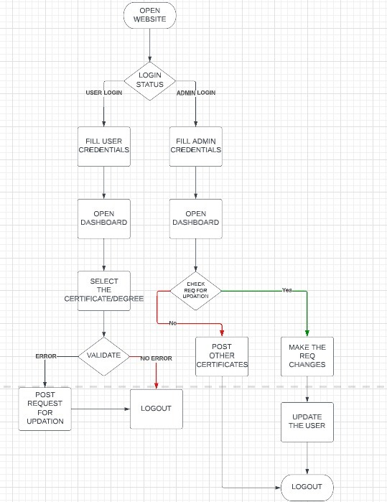
Flowchart

Slide 7
Front-end
Languages used:
HTML : Page layout has been designed in HTML
CSS : CSS has been used for all the desigining part
JavaScript: All the validation task and animations has been developed by JavaScript
At the front-end part student will login with his/her username and password to view his/her certificates and raise query(if any).

Slide 8
Back-end
Languages used are-
PHP : All the business and frontend logic has been implemented in PHP
MySQL : MySQL database has been used as database for the project
At the backend part the admin can insert, update or delete data.
The admin also can process user’s query(if any)
Server used:-
XAMP is the most popular PHP development environment. It is a completely free, easy to install Apache distribution containing MariaDB, PHP, and Perl.

Slide 9
Deployment
Project will be deployed on Heroku.
It supports Java, Node.js, Scala, Clojure, Python, PHP, and Go.
Provides features for a developer to build, run and scale applications.

Slide 10
Dashboard
This interface is used to track the status of the data.
It also shows the analytical representation of the data .

Slide 11
Wireframe

Slide 12
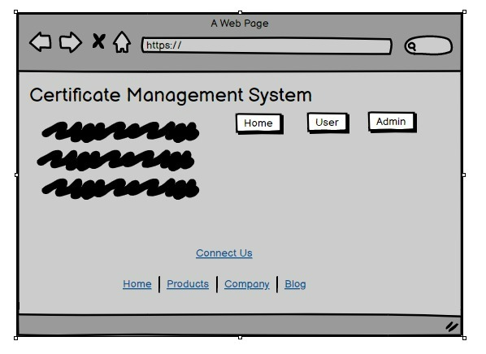
Introduction Page

Slide 13
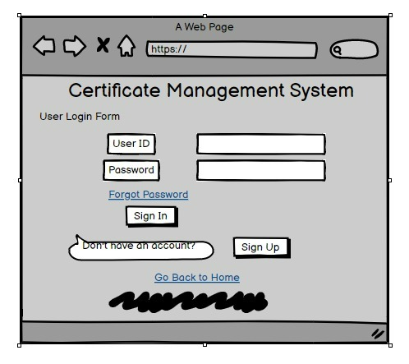
User login Page

Slide 14
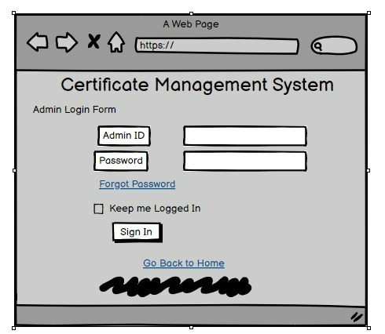
Admin login Page

Slide 15
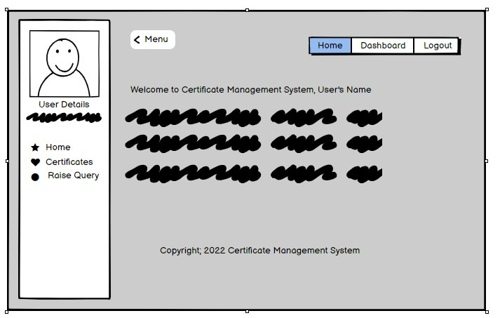
User Page View

Slide 16
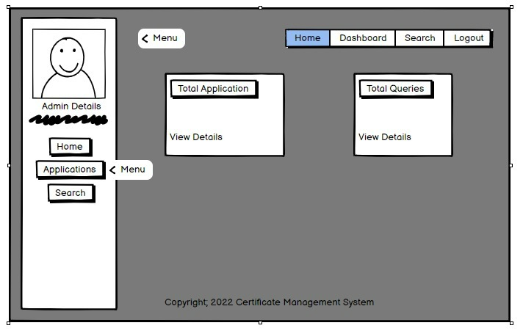
Admin Page View

Slide 17
Conclusion
This web application will be helpful in easy access of the certificates of the students.
One can easily update and edit the various details
Using the dashboard keeps track on the data and various activities.

Slide 18
Milestones
Week 1: Tech-Stack selected -> choose the languages, database, server to be used.
Week 2: Dividing work in teams and start implementing initial phase.
Week 3: Implementation of the project
Week 4: Testing -> finding bugs and resolving them.
Week 5: Deployment on the server.
Week 6: Handover the project to company.

Slide 19
Thankyou

